Slide 1
Covid-19 changes how permanent? or
Two takes on DIGITAL Health IN A CRISIS
NHYDIF, 12 November Jon Hoeksma, CEO DIGITAL HEALTH

Slide 2


Two tAKES oN digital health in a crisis
19 staff
£ <2m budget / founded 2015
Specialist online media and events business
1.4m staff
£140bn budget / founded 1948
Public healthcare system &
widely cherished national institution

Slide 3

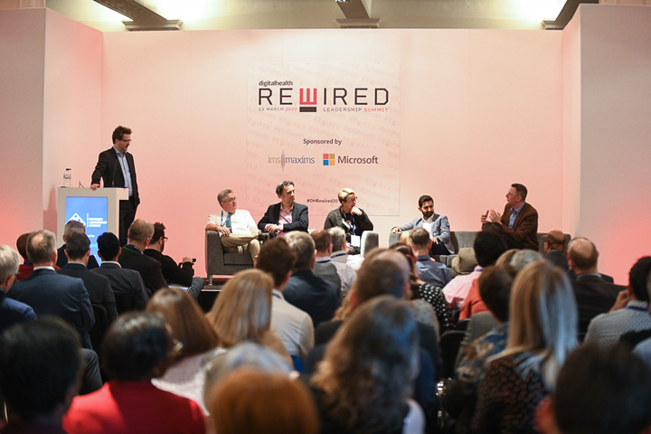
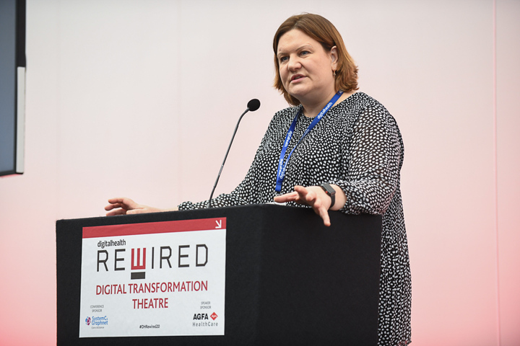



Slide 4
Ran Rewired 2020 3-4 March – immediately before lockdown
Our last physical event of 2020
Quickly switched everything else to virtual – webinars and Virtual Summer School – now Rewired 2021 Virtual Festival
Initially forecast 40% budget reduction
19 staff been working from home since March (3 furloughed brought back)
Ended lease on the Vauxhall office…

Slide 5
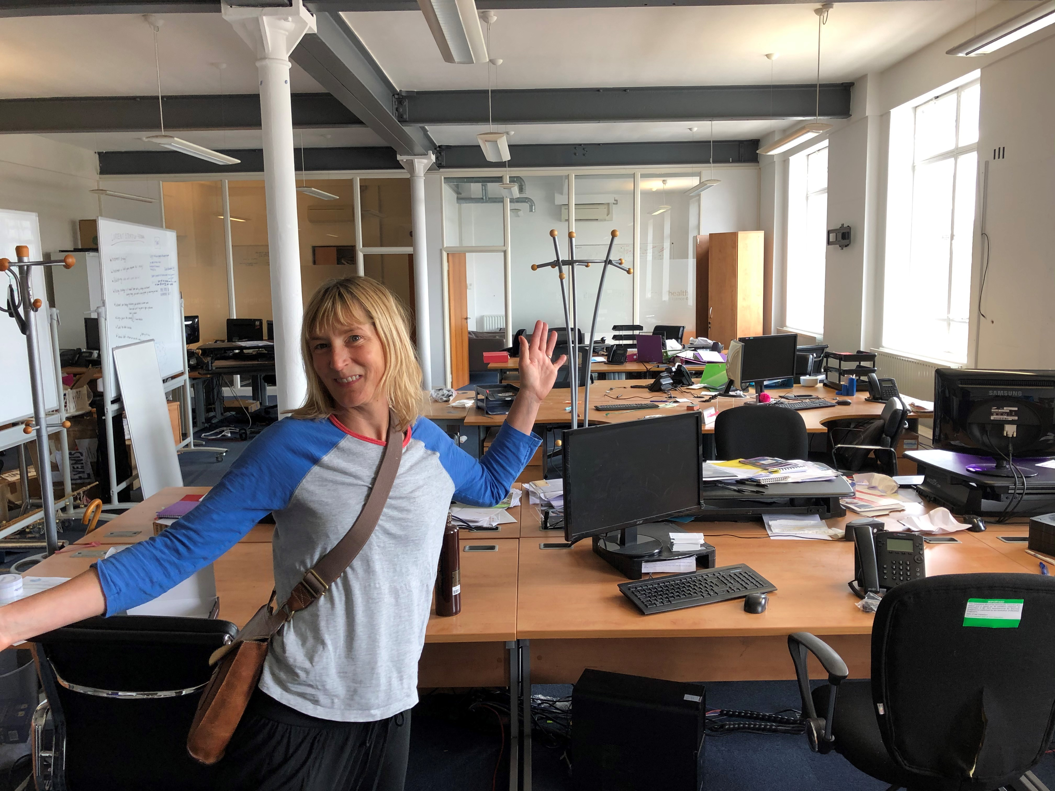

Slide 6
Demand for news and INformation soared
C. 40 Digital Responses to Covid-19 Webinars – connecting national to local leaders in Digital Health Networks --8,000 attendees
April-June were running weekly national briefings. Sarah Wilkinson, Matthew Gould, Simon Eccles, Gareth Thomas, senior execs NHSD/NHSX
Highest ever news traffic – up to 50K on NHS Covid App stories many not understanding we are a news site
Big increases in growth on CCIO/CIO Network passing 6,000 members
1,400 attended Virtual Summer School broadening participation

Slide 7


Slide 8
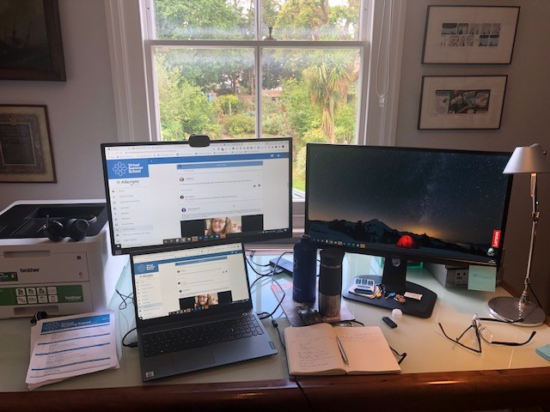
VIRTUAL SUMMER SCHOOL

Slide 9
8-months into the crisis @ Digital Health
As a media and events business we have survived – many haven’t and won’t – by taking decisions early and greater use of digital innovation.
It wasn’t at all clear that we would survive
Prioritising people over bricks and mortar and rapid innovation on events
Its tough on the people – combination of anxiety, uncertainty and social isolation tales a cumulative toll on people
Trying to take care of my team and watch out for danger signs

Slide 10
What next
Future is blended events – have invested in technology
Digital Health Rewired Festival 15-19 March www.digitalhealthrewired.net
Developed monthly Regional Network Events
Running consultation events and exercises for NHSD and NHSX
Delivering virtual events on agency basis OpenEHR 24 November
Significantly grown our Intelligence and consulting (including investing in replatform while can’t run physical events)

Slide 11


Slide 12
PART 2 – NHS DIGITAL HEALTH IN THE CRISIS
National political leadership has been mixed– often appearing to be late or indecisive on key decisions
The NHS by contrast has responded fantastically to the crisis.
The crisis response on use of digital and data has been remarkable
However, have we really had five-years of digital progress on five months?
And will the digital response to the pandemic prove a watershed?
How deep-seated is the digital revolution?

Slide 13
NHS Digital achievements IN 1ST Wave
Rapid move to remote care from March across NHS
Mass support of remote working for NHS staff – infrastructure, hardware, remote access and very rapid roll-out of Teams
Digital infrastructure of Nightingale Hospitals
Local and regional data sharing and IG
Suspension of usual bureaucracy (after a slow start)

Slide 14
Many, many local NHS examples of innovation
Supporting the mental wellbeing through technology @ SLAM
Digital support care homes @ Gloucestershire
Virtual wards @ NW London
Connecting patients to paramedics @ NE Ambulance Trust
Robotics and Telemedicine @ Alder Hey
Scaling EPR @ Cambridge *
Video Consultations for virtual ward round @ Hertfordshire Community
https://nhsproviders.org/spotlight-on-digital-transformation-in-response-to-covid-19/case-studies

Slide 15
Digital priorities in 2nd Wave
Digital Care Homes (iPads)
Pharmacy
National Vaccination Programme
Virtual Care
Population Health
Diagnostic Imaging

Slide 16
BUT The PICTURE IS Also MORE NUANCED
Attend Anywhere proved problematic and questions on procurement
Video consultations grew hugely, but from very low base, and the vast majority of remote consultations by phone ~ often overlooked in national media
MS Teams licensing short-term end March 2021– limited clinical take-up so far
NHS Covid-19 App had uncertain start and minimal impact so far
Test and Trace has proved hugely expensive (£12 billion) and marginal impact
Future of COPI (control of patient information) notices. Are they now a permanent feature?

Slide 17
how is NHS doing on digital?
‘Digital Transformation in the NHS’, House of Commons PAC, 6 November, 2020
DHSC has not learned from past IT programme failures
“DHSC and NHS have “none” of the essential components in place to turn around “track record of expensive, failed IT programmes”.
It concludes that in 2020, “none” of the components essential to successful delivery of the digital ambition for the NHS - effective governance, realistic and detailed plans, sufficient investment nationally and locally, and clear accountability - are in place.

Slide 18
PAC’s conclusion:
“The response to the pandemic demonstrates it is possible to reset and adopt new digital solutions and technologies. But there needs to be a clear strategy that works with local trusts and acknowledges the financial pressures they are under.”
Meg Hillier MP, Chair of the Public Accounts Committee.

Slide 19
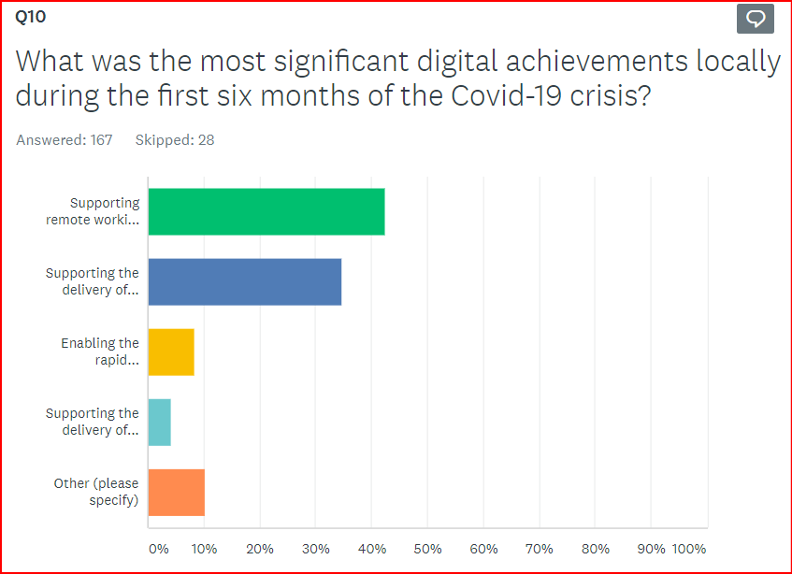
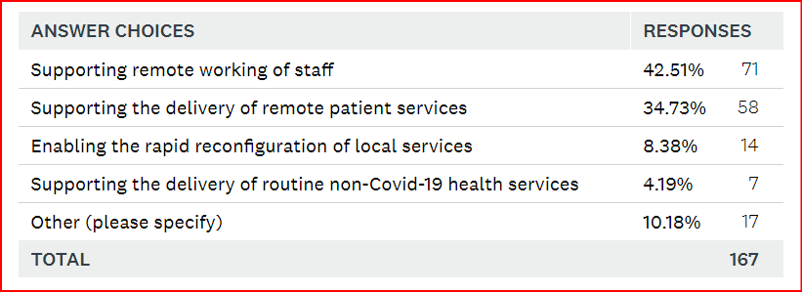
Digital Health Intelligence NHS IT Leadership Survey 2020 – early preview of Covid-19 question responses (Nov 2020)

Slide 20
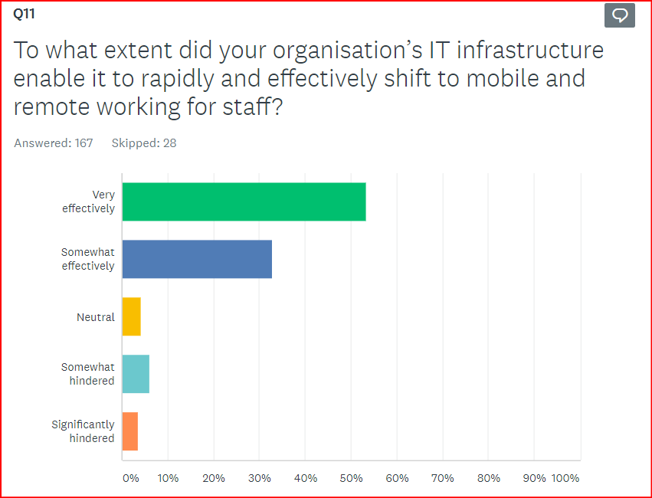
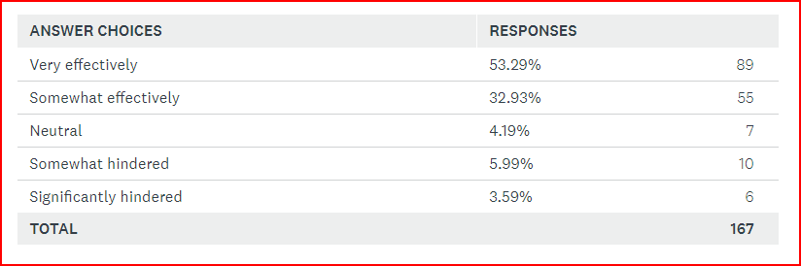

Slide 21
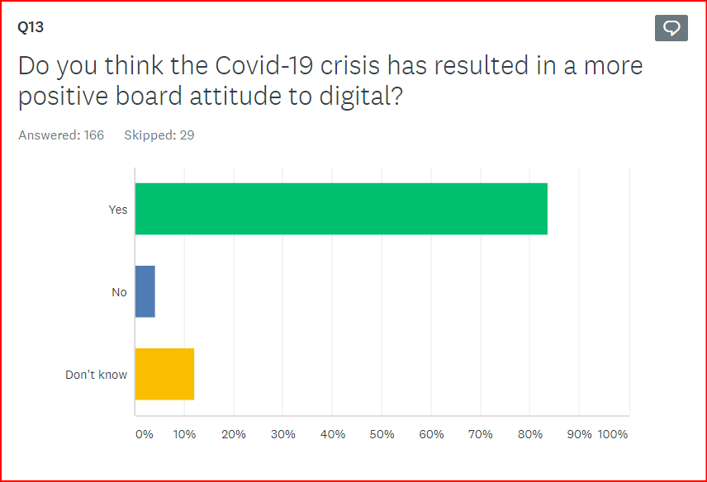

Slide 22
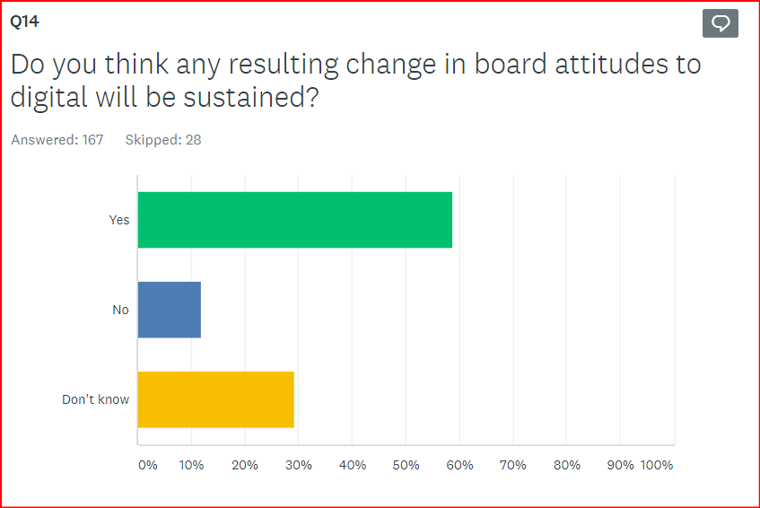

Slide 23
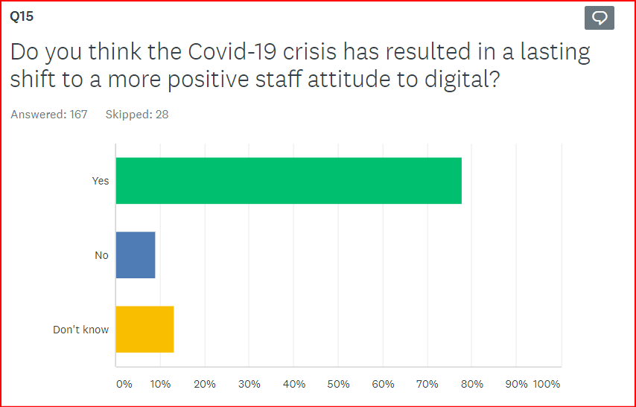

Slide 24
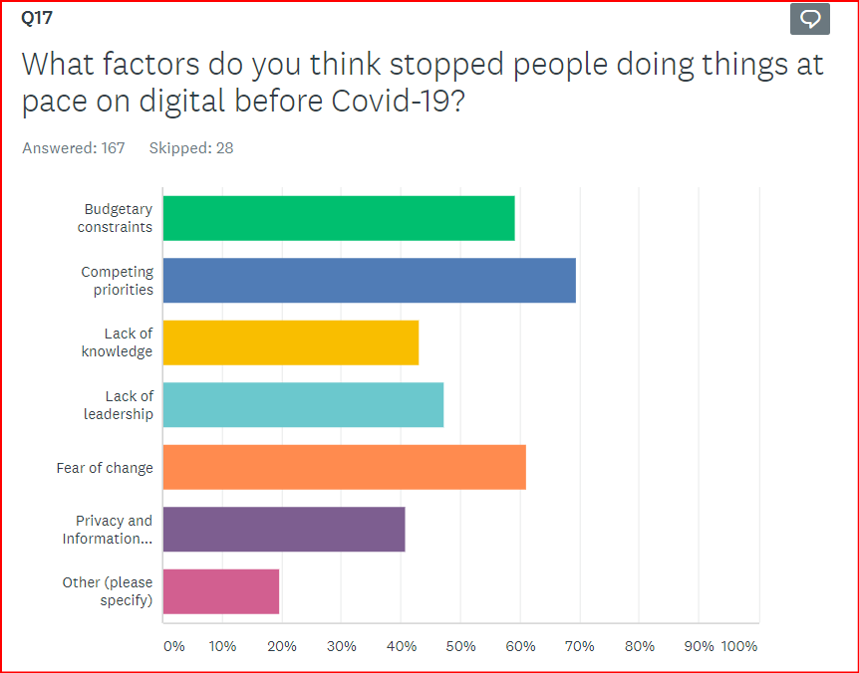
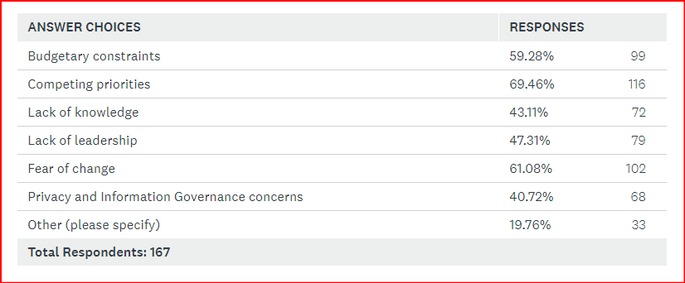

Slide 25
In conclusion:
NHS has proved that it can deliver remarkable progress on digital in a unique crisis, when facing truly ‘wicked’ problems
There is a good reason to think that the shared lived experience of the crisis has created a decisive shift on attitudes to digital and data at all levels
‘Fear of change’ and ‘competing priorities’ hold us back as much as budgetary constraints
Need to evidence and secure those digital gains to avoid taking a step back post crisis
National policy at DHSC on NHS IT remains an abject incoherent mess according to the PAC (almighty reorganisation coming from Wade-Gehry Review)
An estimated £8bn required to complete NHS digitisation (PAC) – but public finances poor

Slide 26
Thank you
Questions
jon@digitalhealth.net

